Slide 1
GIP presentation
The pinball machine by Robin monsere

Slide 2
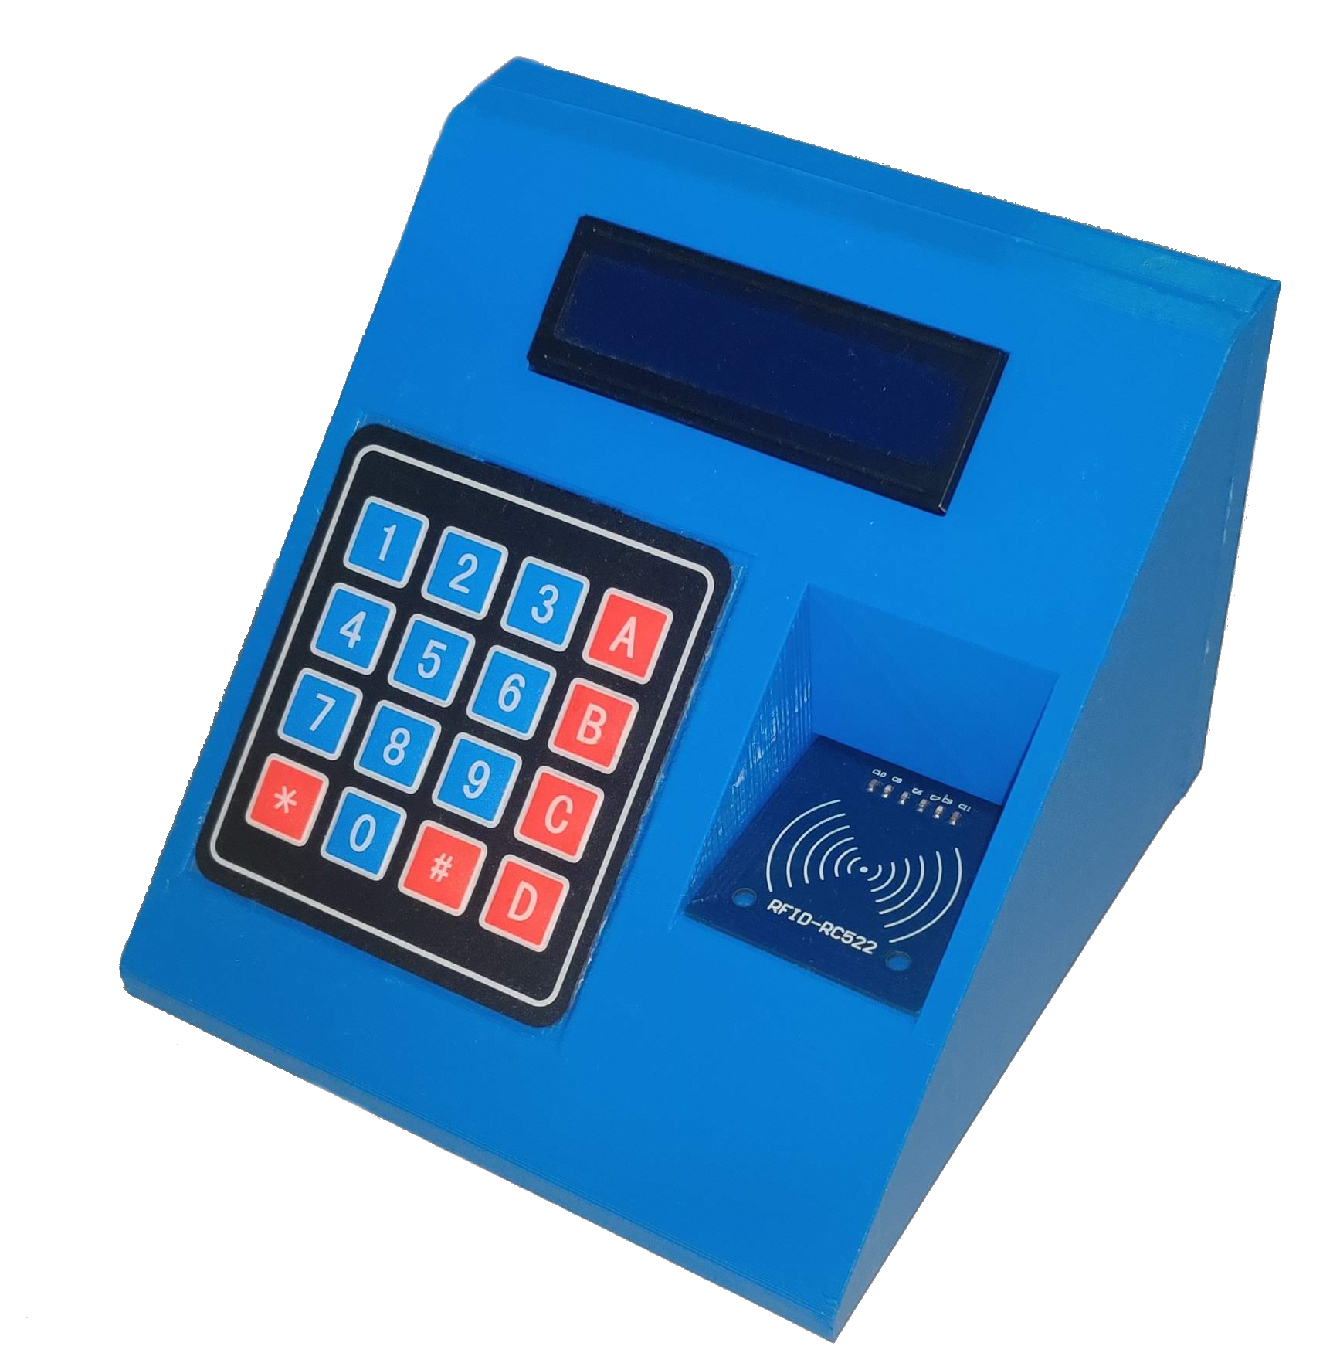
2 parts

Slide 3
No external partner/company

Slide 4
Why a pinball machine?
Had a lot of ideas
Has electronics/software/hardware
Wanted to learn RFID

Slide 5
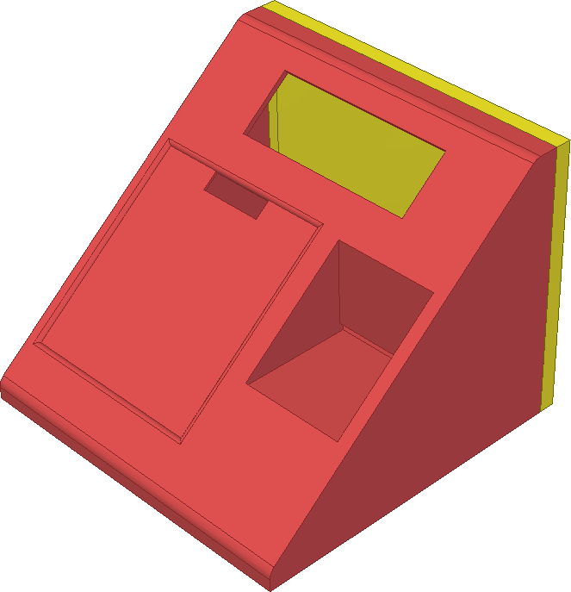
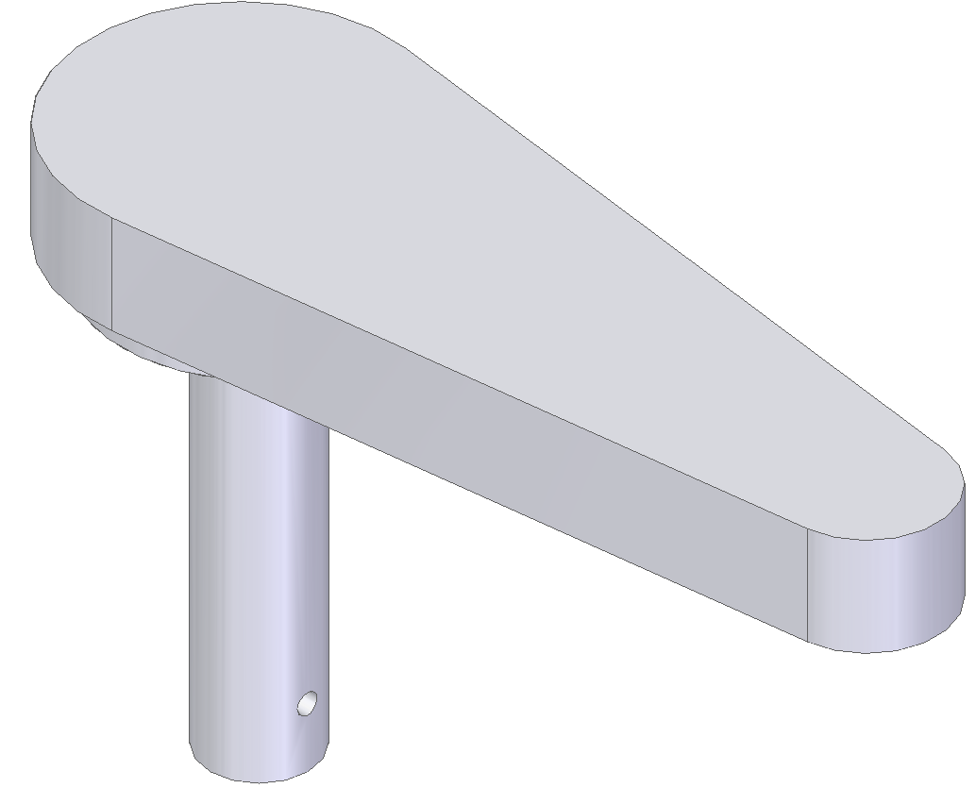
How? – 3D Printing
Sketches
3D Drawing
Printing

Slide 6

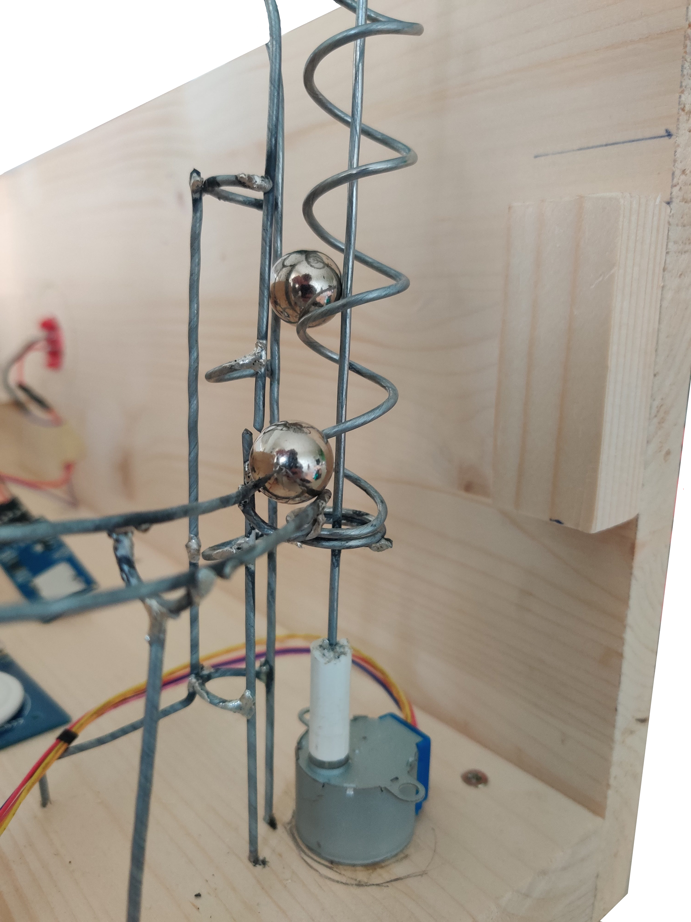
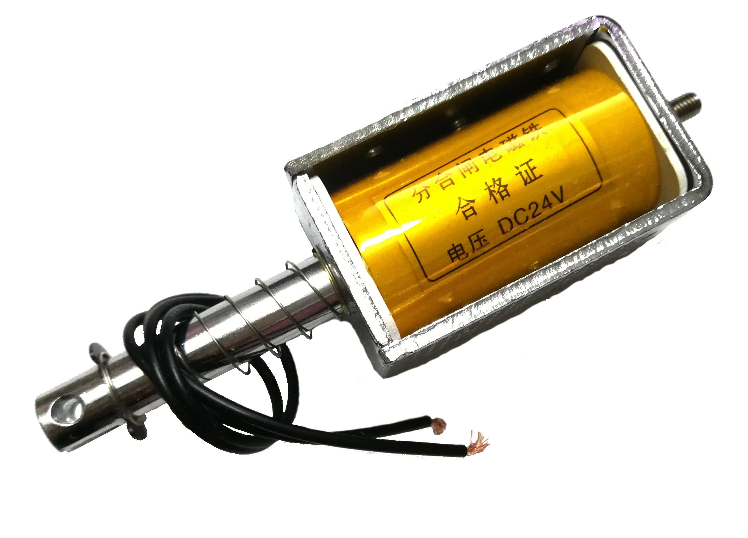
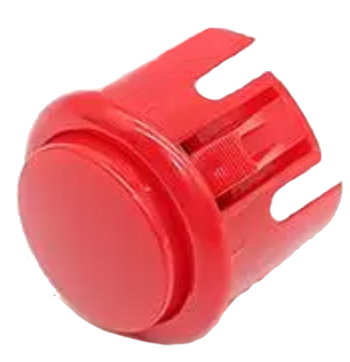
How? – pinball machine
Wood
Marble Tracks
Solanoids
30cm*45cm*25cm

Slide 7
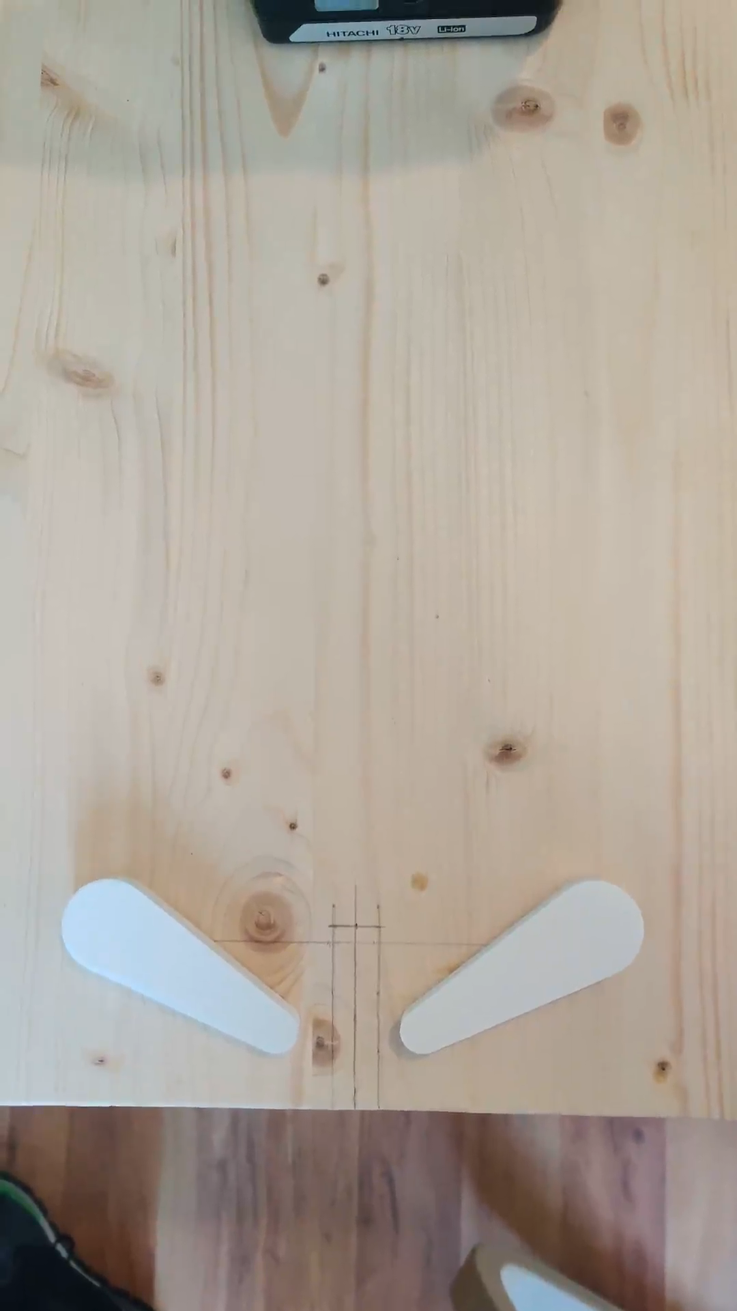
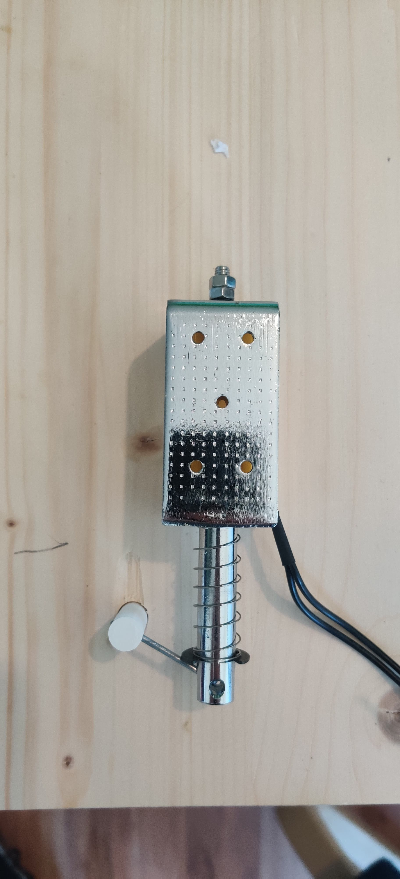
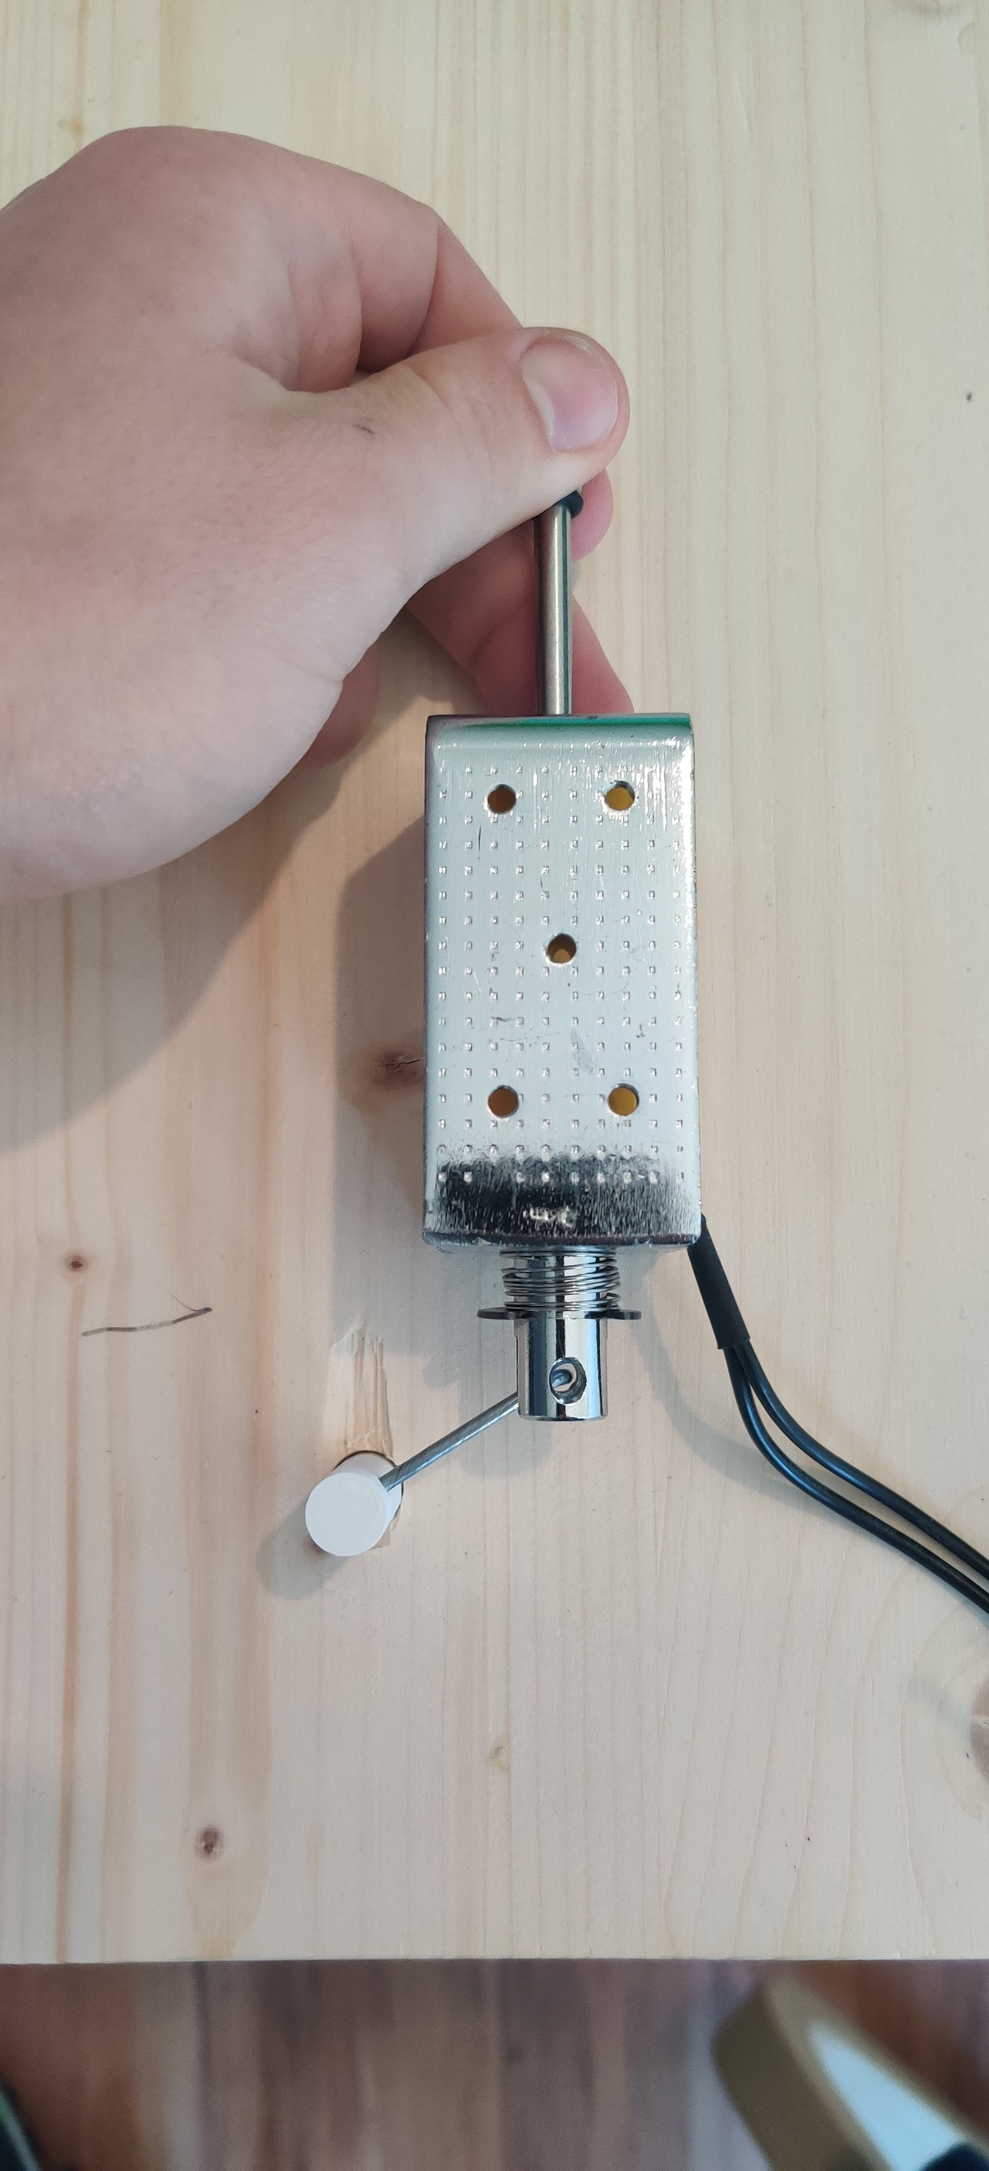
How? – flippers

Slide 8
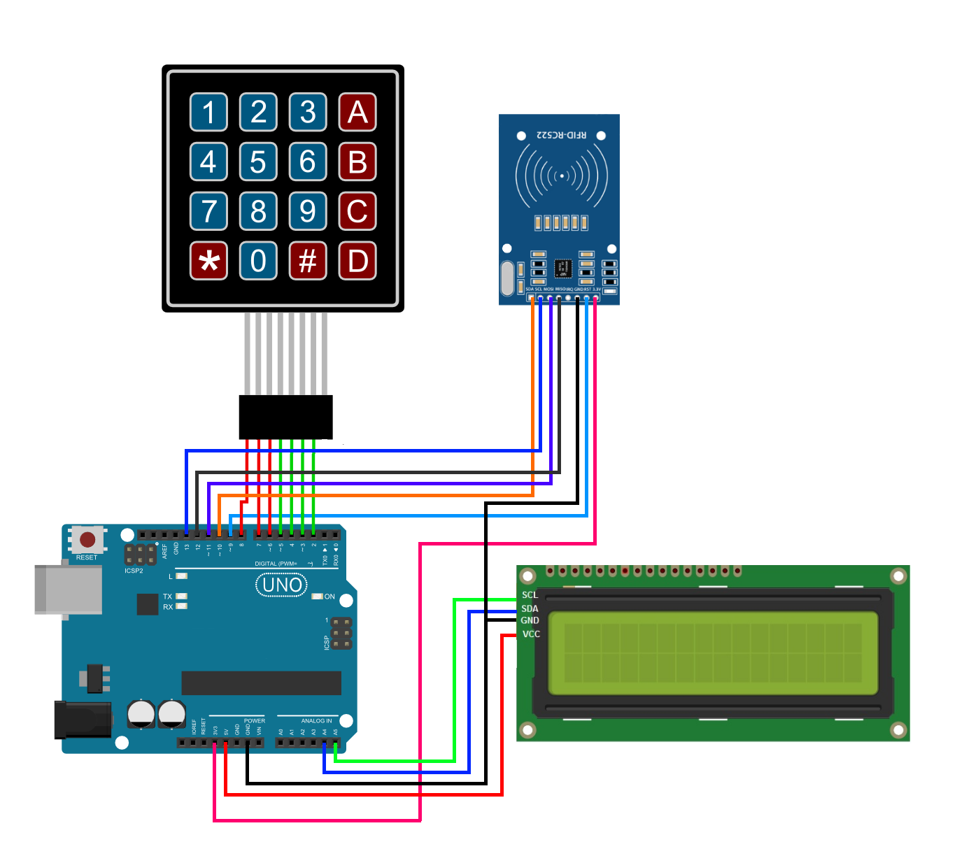
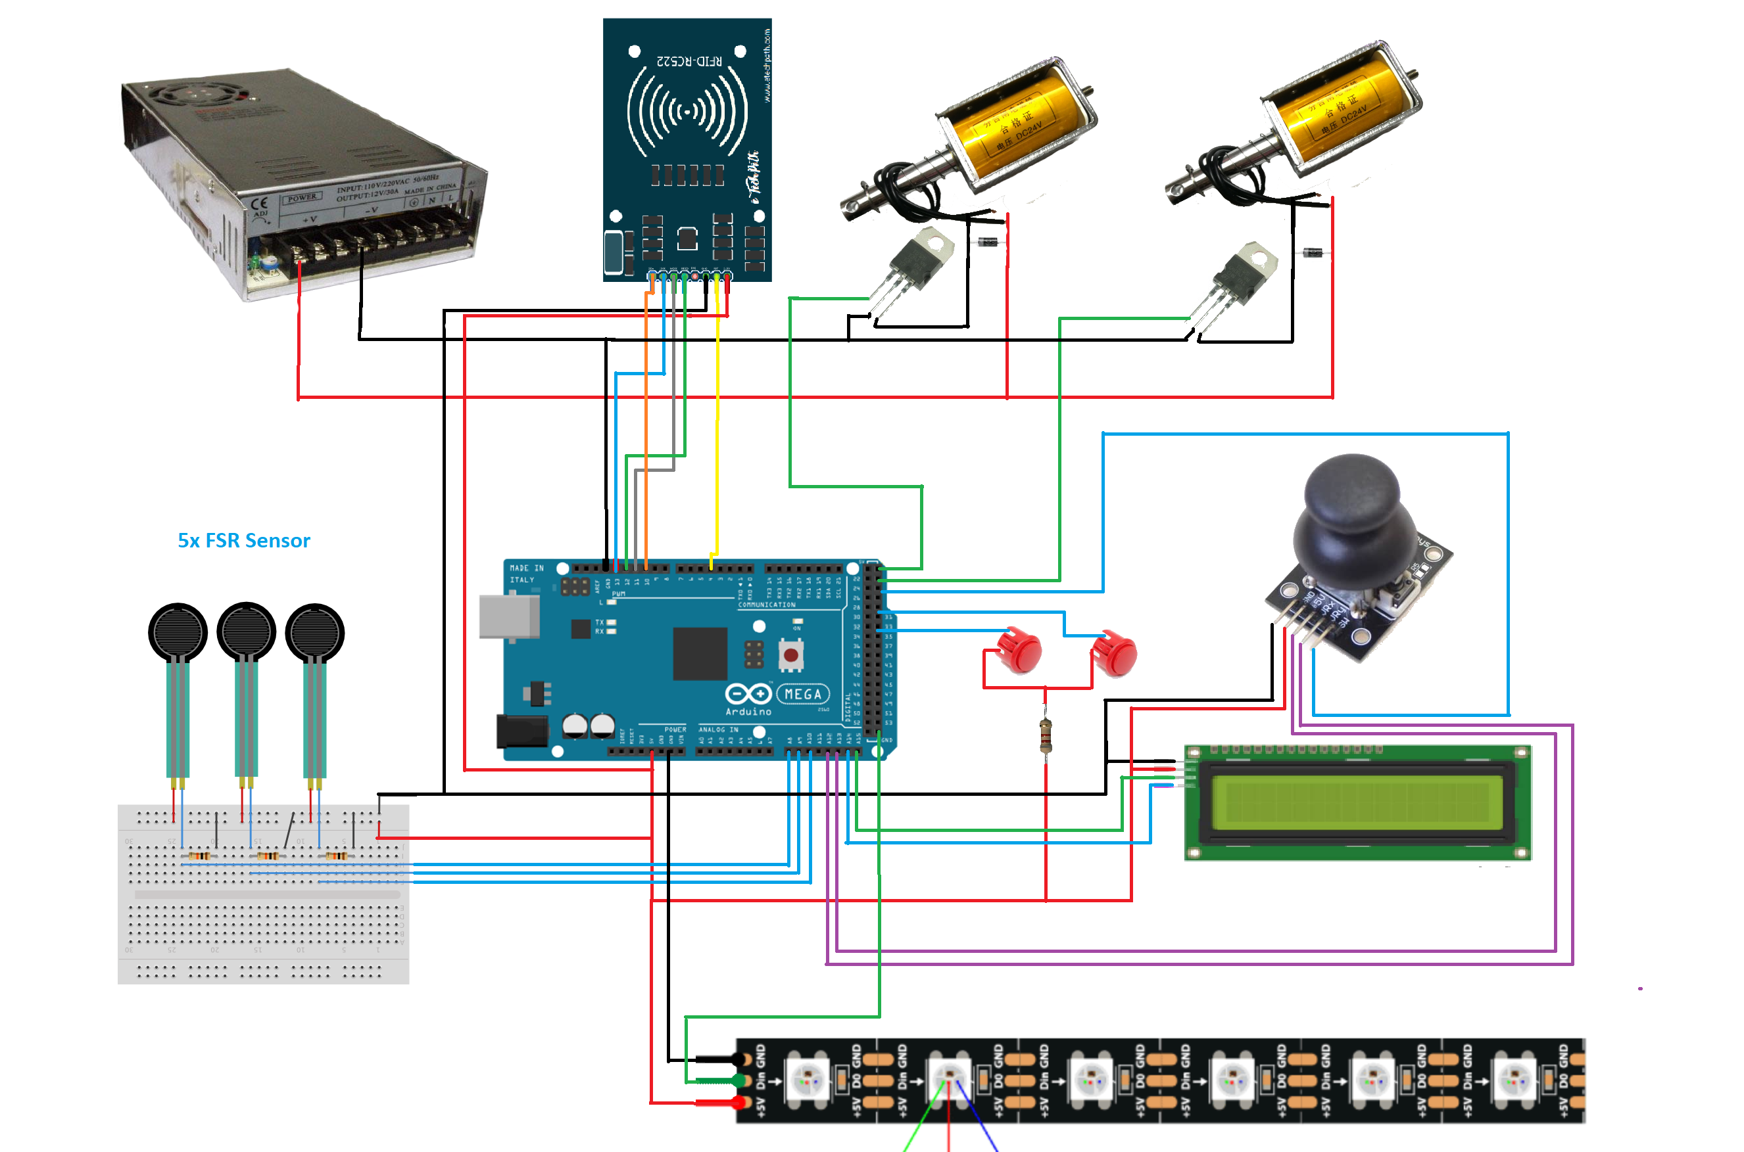
How? – Electronics
Sketches
Connect and Test
Soldering
Arduino Mega/Uno

Slide 9

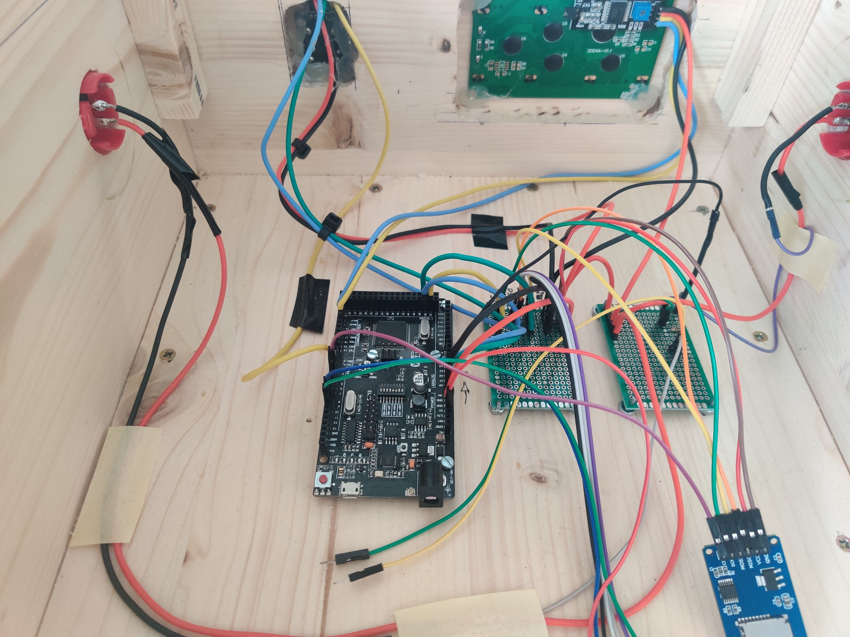

Slide 10
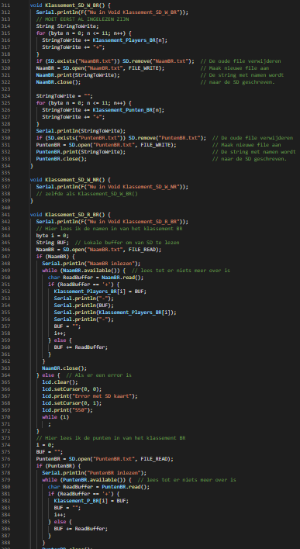
How? – Code
Arduino IDE
C++

Slide 11
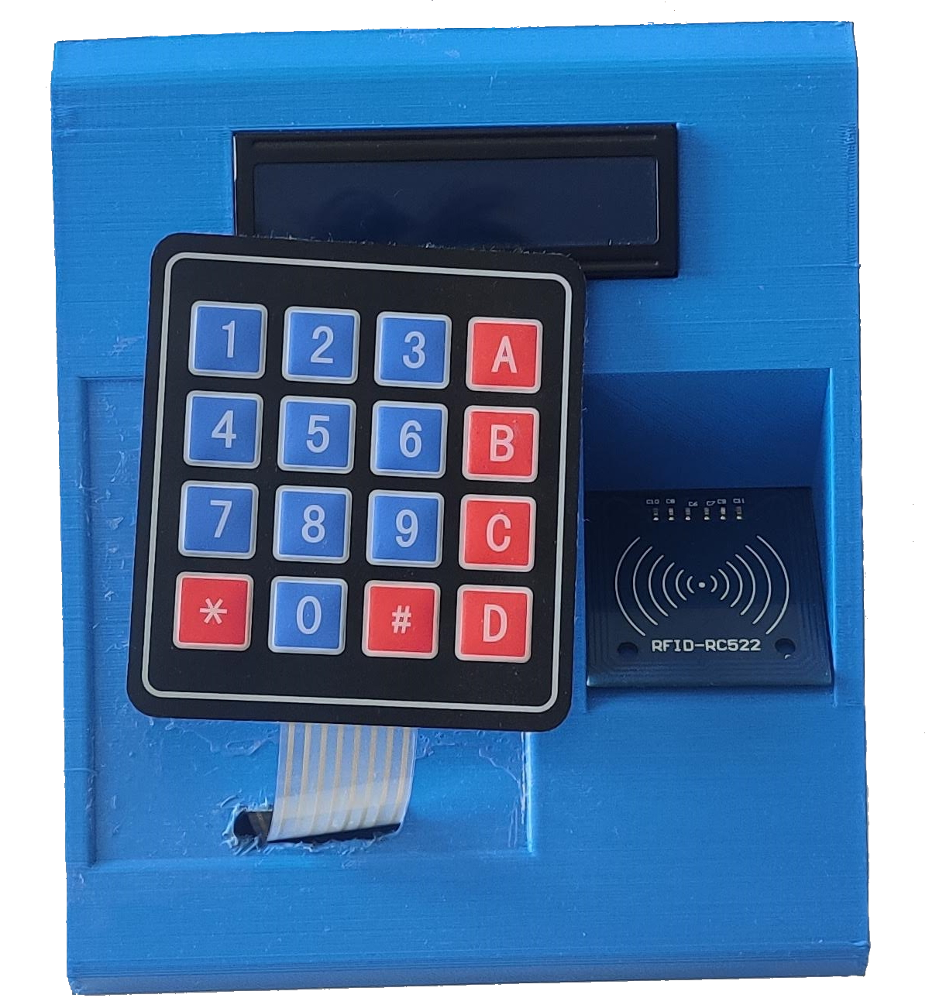
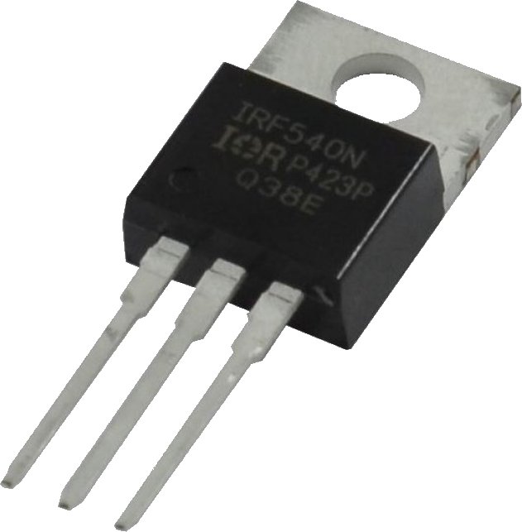
Issues
TIMING!
Design Mistake
Wrong MOSFET
Not Loud Enough

Slide 12
What did I learn

Slide 13
Does it work?
No, not yet…

